Slide 1
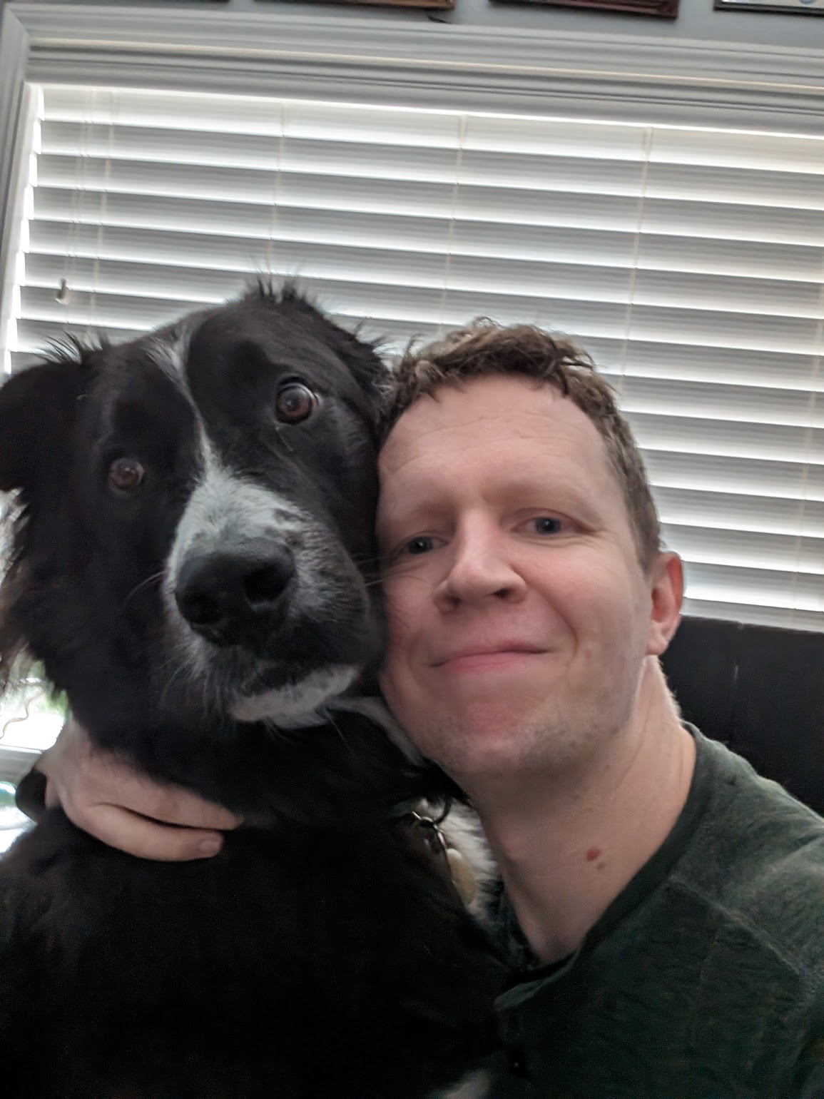
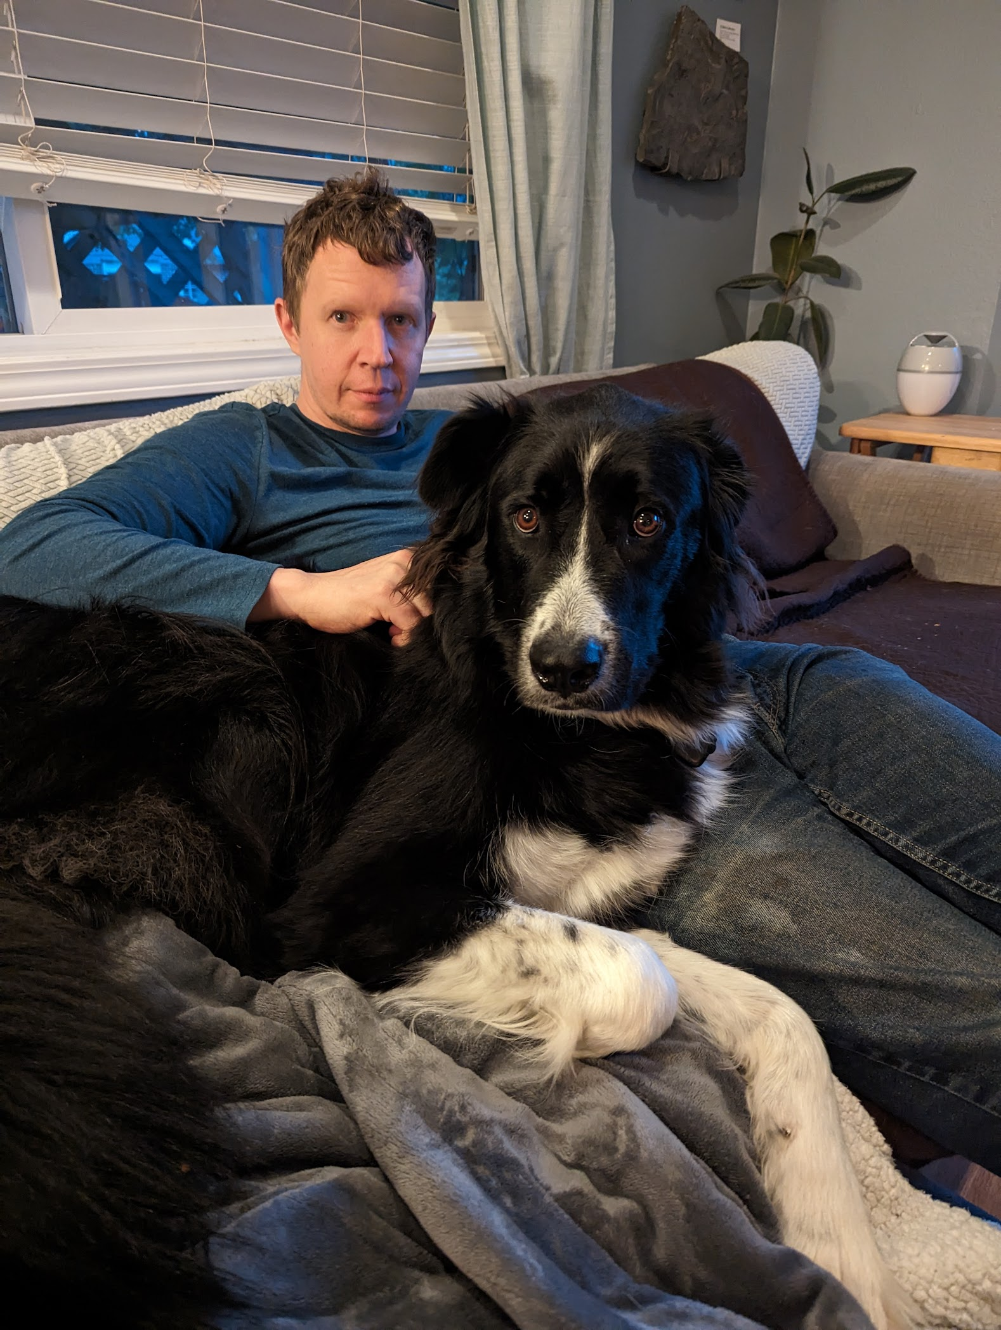
Next Up:
Justin Grote

Slide 2
3
3

Slide 3
2

Slide 4
1

Slide 5
EverythingFast: Developing Performant Modules
Justin Grote

Slide 6

Many thanks to our sponsors:

Slide 7
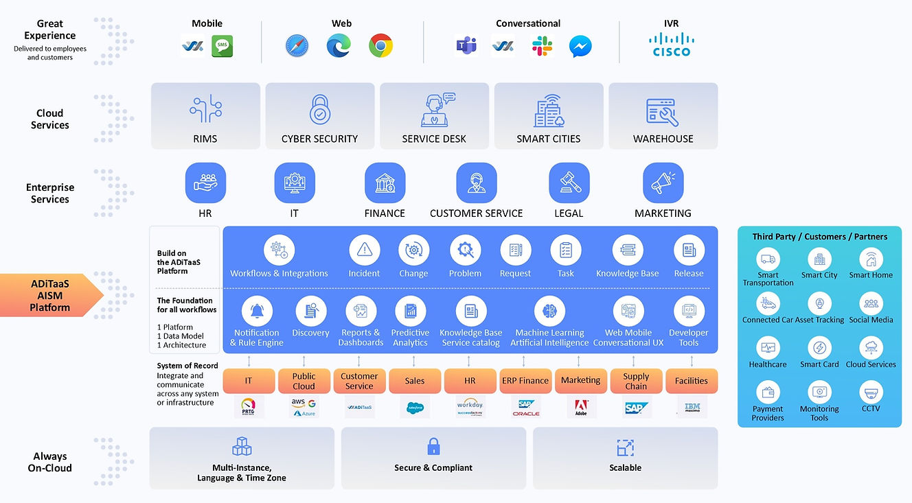

Thank you Allied Digital!

Slide 8


Justin Grote
Datacenter Solutions Architect Allied Digital Services LLC
5x Microsoft MVP
PowerShell VSCode, Pester VSCode, PowerHTML, ModuleFast, SecretManagement, PoshNMAP, IPNetwork, Press, etc.
Session Content

Slide 9
Session Content

Slide 10
Q&A
15 minutes
Session Content

